Slide 1
Al-Farabi Kazakh National University
Higher School of Medicine
Epigenomics
Lecturer: PhD Pinsky Ilya Vladimirovich

Slide 2
LEARNING OUTCOMES
As a result of the lesson you will be able to:
1. Explain the difference between the terms “genetics” and “epigenetics”, “genomics” and “epigenomics”.
2. Explain the term “gene expression” and different mechanisms of inheritance.
3. Describe the mechanisms of gene expression regulation on the transcriptional and post-transcriptional level in procaryotes and eucaryotes.
4. Characterize the histone modifications and their influence on gene expression.
5. Explain the mechanisms of environmental influence on gene expression.

Slide 3
https://www.google.com/url?sa=i&url=https%3A%2F%2Fslideplayer.com%2Fslide%2F10679006%2F&psig=AOvVaw1hFuluDt2MCe4XtF0QOPVa&ust=1644783296678000&source=images&cd=vfe&ved=0CAwQjhxqFwoTCJj6ycb9-vUCFQAAAAAdAAAAABAV

Slide 4
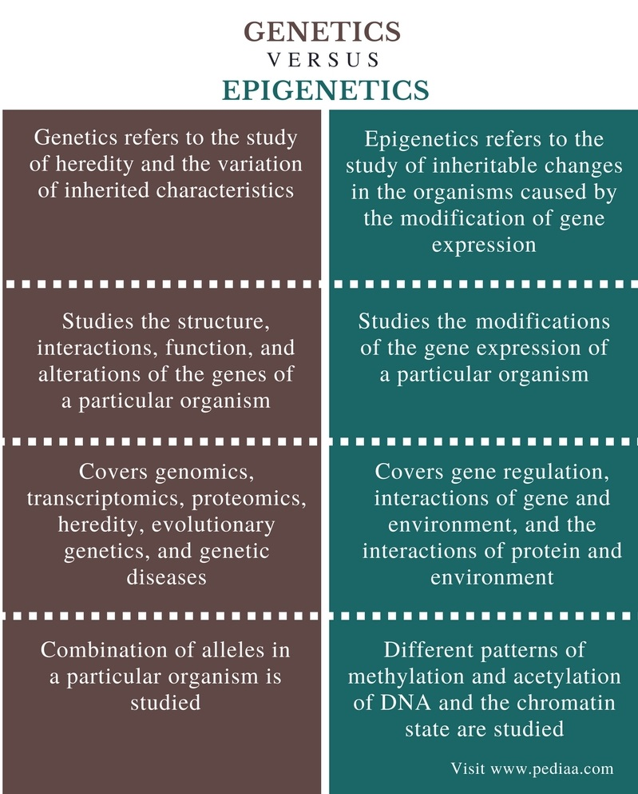

Slide 5
https://sciencecases.lib.buffalo.edu/collection/detail.html?case_id=656&id=656

Slide 6
https://www.google.com/url?sa=i&url=https%3A%2F%2Fwww.slideserve.com%2Fedeline%2Ftypes-of-inheritance&psig=AOvVaw19CdM44w0MgNuZvYUdv89X&ust=1644780823563000&source=images&cd=vfe&ved=0CAwQjhxqFwoTCLj_9J70-vUCFQAAAAAdAAAAABA_

Slide 7
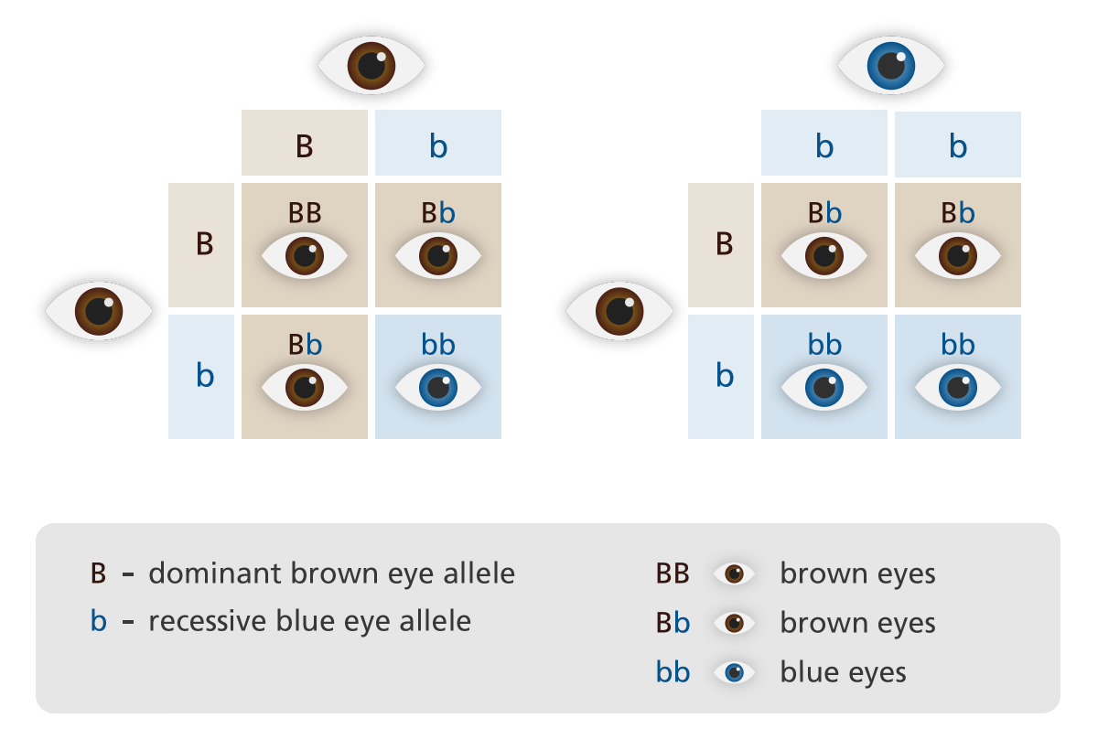
Complete dominance
https://www.google.com/url?sa=i&url=https%3A%2F%2Fwww.yourgenome.org%2Ffacts%2Fwhat-are-dominant-and-recessive-alleles&psig=AOvVaw19CdM44w0MgNuZvYUdv89X&ust=1644780823563000&source=images&cd=vfe&ved=0CAwQjhxqFwoTCLj_9J70-vUCFQAAAAAdAAAAABA4

Slide 8
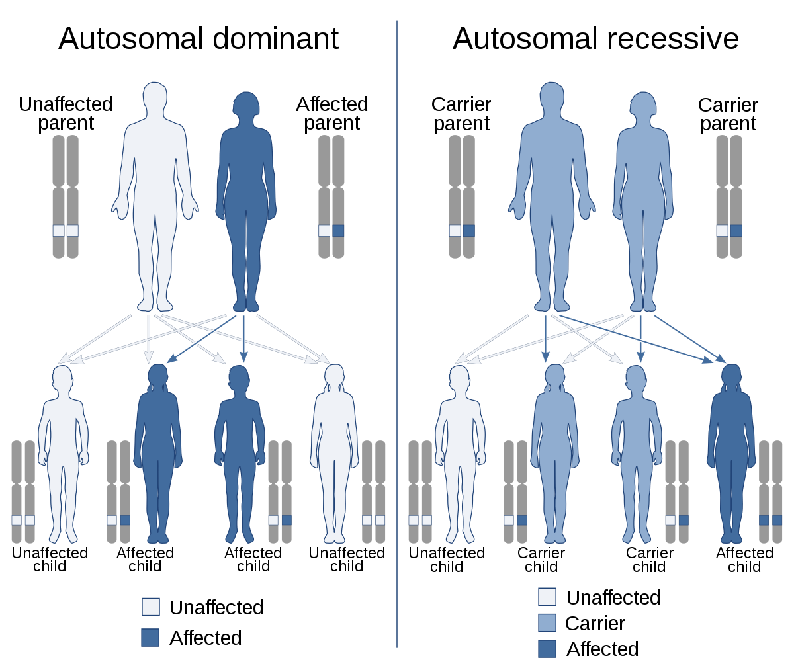
https://www.google.com/url?sa=i&url=https%3A%2F%2Fen.wikipedia.org%2Fwiki%2FDominance_(genetics)&psig=AOvVaw19CdM44w0MgNuZvYUdv89X&ust=1644780823563000&source=images&cd=vfe&ved=0CAwQjhxqFwoTCLj_9J70-vUCFQAAAAAdAAAAABAZ

Slide 9
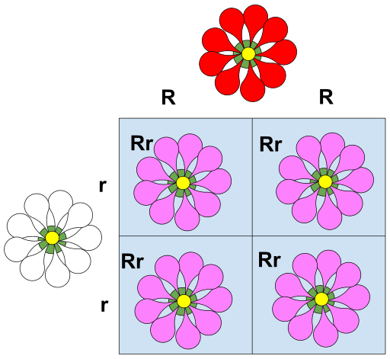
Incomplete dominance
https://www.google.com/url?sa=i&url=https%3A%2F%2Fbiologydictionary.net%2Fincomplete-dominance%2F&psig=AOvVaw19CdM44w0MgNuZvYUdv89X&ust=1644780823563000&source=images&cd=vfe&ved=0CAwQjhxqFwoTCLj_9J70-vUCFQAAAAAdAAAAABAK

Slide 10
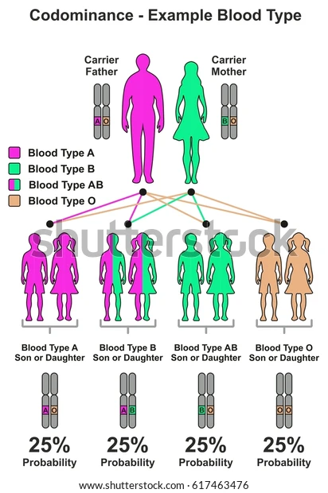
https://www.shutterstock.com/ru/image-illustration/codominance-example-blood-type-infographic-diagram-617463476

Slide 11
https://www.google.com/url?sa=i&url=https%3A%2F%2Fwww.youtube.com%2Fwatch%3Fv%3DEP8ZytVnU3Q&psig=AOvVaw0LKm4nMlTXFDk75e9Tnzsj&ust=1644782573103000&source=images&cd=vfe&ved=0CAsQjRxqFwoTCJC1r9v6-vUCFQAAAAAdAAAAABAS

Slide 12
https://www.google.com/url?sa=i&url=https%3A%2F%2Fwww.youtube.com%2Fwatch%3Fv%3DRPl-PtkN1fE&psig=AOvVaw36oK_SWDD9t3ZOfejImr7j&ust=1644782959296000&source=images&cd=vfe&ved=0CAwQjhxqFwoTCNiC-Jb8-vUCFQAAAAAdAAAAABAO

Slide 13
https://www.google.com/url?sa=i&url=https%3A%2F%2Fsocratic.org%2Fquestions%2Fhow-does-gene-regulation-differ-in-prokaryotes-and-eukaryotes&psig=AOvVaw1xWTSpavtkSemCkJWhKTgp&ust=1644783775894000&source=images&cd=vfe&ved=0CAwQjhxqFwoTCMDr-53_-vUCFQAAAAAdAAAAABA7

Slide 14
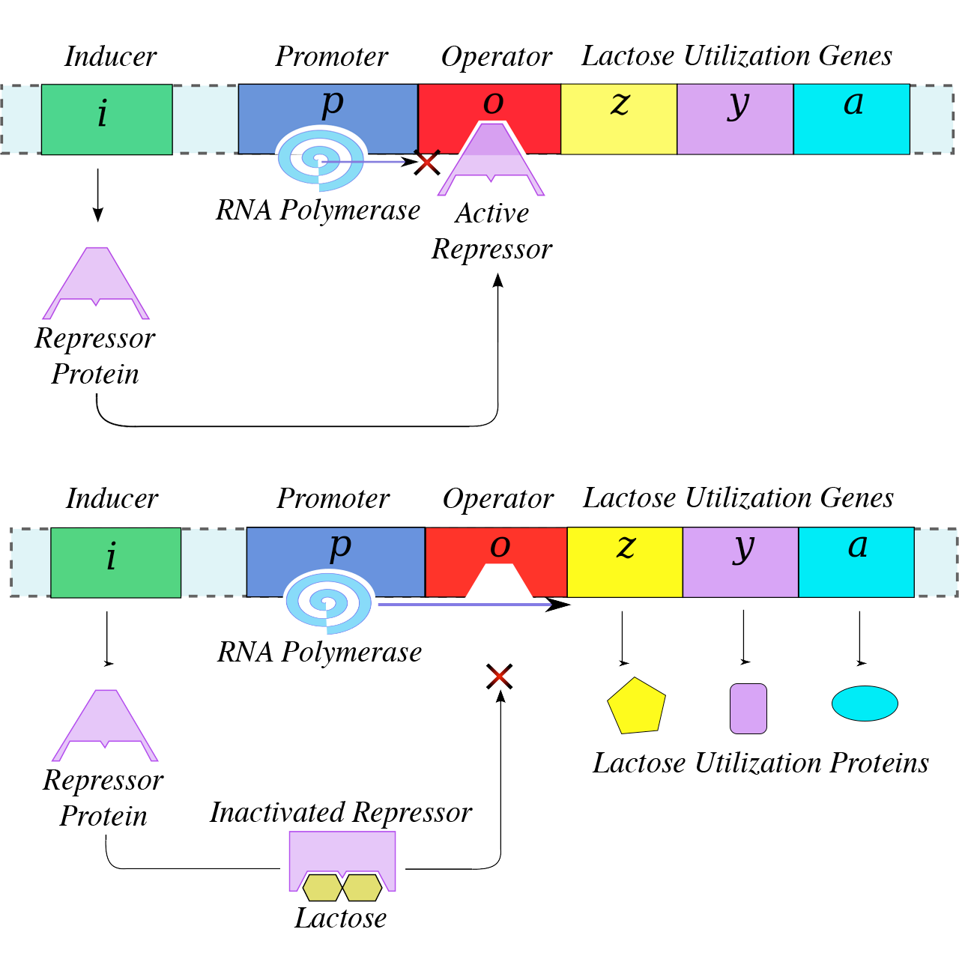
Regulation of procaryotic Lac-operon
https://www.google.com/url?sa=i&url=https%3A%2F%2Fcourses.lumenlearning.com%2Fwm-biology1%2Fchapter%2Fprokaryotic-gene-regulation%2F&psig=AOvVaw1xWTSpavtkSemCkJWhKTgp&ust=1644783775894000&source=images&cd=vfe&ved=0CAsQjRxqFwoTCMDr-53_-vUCFQAAAAAdAAAAABA1

Slide 15
Eukaryotic gene expression can be regulated at many stages
Eukaryotic gene expression involves many steps, and almost all of them can be regulated. Different genes are regulated at different points, and it’s not uncommon for a gene (particularly an important or powerful one) to be regulated at multiple steps.
Chromatin accessibility. The structure of chromatin (DNA and its organizing proteins) can be regulated. More opened or “relaxed” chromatin makes a gene more available for transcription.
Transcription. Transcription is a key regulatory point for many genes. Sets of transcription factor proteins bind to specific DNA sequences in or near a gene and promote or repress its transcription into an RNA.
RNA processing. Splicing, capping, and addition of a poly-A tail to an RNA molecule can be regulated, and so it can exit from the nucleus. Different mRNAs may be made from the same pre-mRNA by alternative splicing.

Slide 19
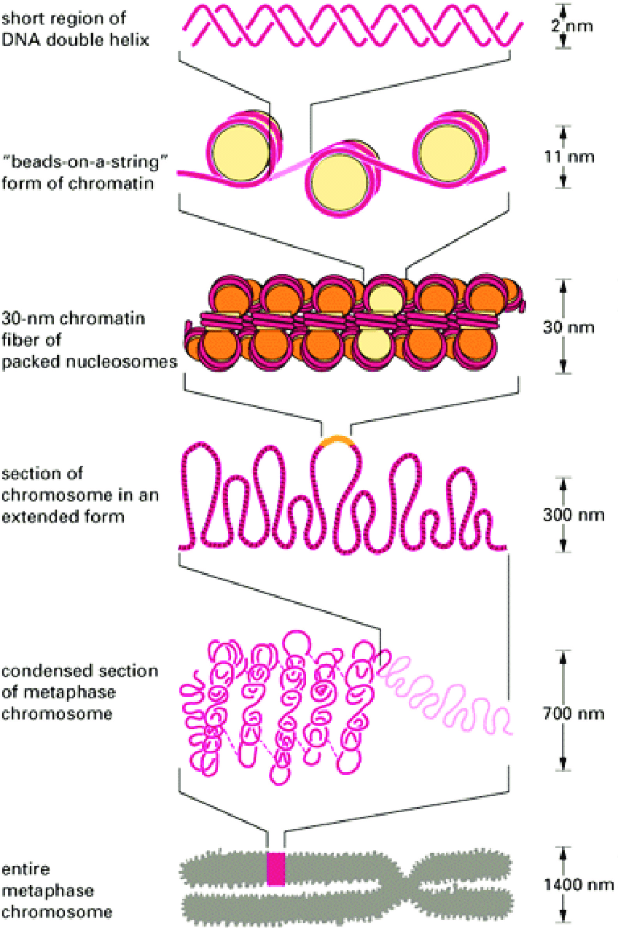
https://www.google.com/url?sa=i&url=https%3A%2F%2Fwww.researchgate.net%2Ffigure%2FChromatin-structure-http-csma31csmjmuedu-chemistry-faculty-mohler-chromatinhtm_fig17_322565060&psig=AOvVaw32leZizUvl4BeDvGElBppW&ust=1636375234179000&source=images&cd=vfe&ved=2ahUKEwjgn9j1oob0AhVtl4sKHcSACA0Qr4kDegUIARDLAQ

Slide 20
Figure 1. Methylation of cytosine to form 5-methylcytosine. SAM (S-adenosyl methionine) serves as the source of the methyl group, giving SAH (S-adenosyl-L-homocysteine) as a by-product.
https://sciencecases.lib.buffalo.edu/collection/detail.html?case_id=656&id=656

Slide 21
Figure 2. Differential DNA methylation between two sets of monozygotic twins, one set at age 3 (left), one set at age 50 (right) using AIMS (amplification of intermethylated sites). Different bands, corresponding to sibling-specific changes of DNA methylation, are indicated with arrows. (Panel A of Figure 2 in Fraga et al., 2005. Epigenetic differences arise during the lifetime of monozygotic twins. PNAS 102:10604–10609. Copyright 2005 National Academy of Sciences, USA.)
https://sciencecases.lib.buffalo.edu/collection/detail.html?case_id=656&id=656

Slide 22
Figure 3. Mapping of chromosomal regions with differential DNA methylation in monozygotic twins using comparative genomic hybridization for methylated DNA. Four representative chromosome pairs are shown. Methylated DNA from one twin was labeled with a red fluorescent dye, while methylated DNA from the other twin in the pair was labeled with a green dye. Both sets of twin DNA were hybridized to normal metaphase chromosomes. The yellow color represents equal amounts of red and green dye hybridizing to the chromosomes, indicative of similar levels of DNA methylation at those particular chromosomal locations. (Figure 3 of Fraga et al., 2005. Epigenetic differences arise during the lifetime of monozygotic twins. PNAS 102:10604–10609. Copyright 2005 National Academy of Sciences, USA.)
https://sciencecases.lib.buffalo.edu/collection/detail.html?case_id=656&id=656

Slide 26
How do cells "decide" which genes to turn on?
Broadly speaking, we can say that a cell's gene expression pattern is determined by information from both inside and outside the cell.
Examples of information from inside the cell: the proteins it inherited from its mother cell, whether its DNA is damaged, and how much ATP it has.
Examples of information from outside the cell: chemical signals from other cells, mechanical signals from the extracellular matrix, and nutrient levels.
https://sciencecases.lib.buffalo.edu/collection/detail.html?case_id=656&id=656

Slide 27
A growth factor is a chemical signal from a neighboring cell that instructs a target cell to grow and divide. We could say that the cell "notices" the growth factor and "decides" to divide, but how do these processes actually occur?
https://sciencecases.lib.buffalo.edu/collection/detail.html?case_id=656&id=656

Slide 28
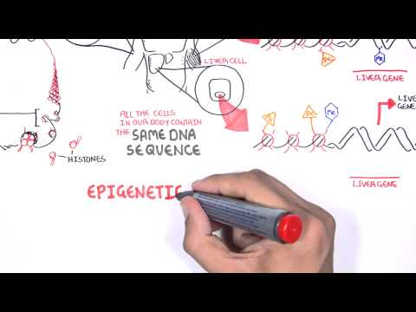

Slide 29
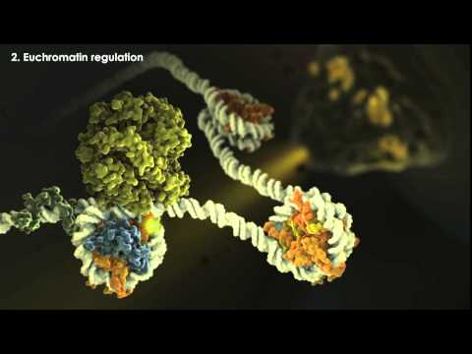

Slide 30
References
1. Dupont C, Armant DR, Brenner CA (September 2009). "Epigenetics: definition, mechanisms and clinical perspective". Seminars in Reproductive Medicine. 27 (5): 351–7. doi:10.1055/s-0029-1237423. PMC 2791696. PMID 19711245.
2. Rutherford, Adam (19 July 2015). "Beware the pseudo gene genies". The Guardian.
3. Russell PJ (2010). iGenetics: A Molecular Approach (3rd ed.). San Francisco: Pearson Benjamin Cummings. ISBN 978-0-321-56976-9.
4. Alabert C, Groth A (February 2012). "Chromatin replication and epigenome maintenance" (PDF). Nature Reviews. Molecular Cell Biology. 13 (3): 153–67. doi:10.1038/nrm3288. PMID 22358331.
5. Ghosh S, Sinha JK, Raghunath M (September 2016). "Epigenomic maintenance through dietary intervention can facilitate DNA repair process to slow down the progress of premature aging". IUBMB Life. 68 (9): 717–21. doi:10.1002/iub.1532. PMID 27364681.
6. "The Potential Epigenetic and Anticancer Power of Dietary Flavones". 2016-10-11.
7. Zhu J, Adli M, Zou JY, Verstappen G, Coyne M, Zhang X, et al. (January 2013). "Genome-wide chromatin state transitions associated with developmental and environmental cues". Cell. 152 (3): 642–54. doi:10.1016/j.cell.2012.12.033. PMC 3563935. PMID 23333102.
8. Laird PW (March 2010). "Principles and challenges of genomewide DNA methylation analysis". Nature Reviews. Genetics. 11 (3): 191–203. doi:10.1038/nrg2732. PMID 20125086.
9. Barski A, Cuddapah S, Cui K, Roh TY, Schones DE, Wang Z, et al. (May 2007). "High-resolution profiling of histone methylations in the human genome". Cell. 129 (4): 823–37. doi:10.1016/j.cell.2007.05.009. PMID 17512414.
10. Kouzarides T (February 2007). "Chromatin modifications and their function". Cell. 128 (4): 693–705. doi:10.1016/j.cell.2007.02.005. PMID 17320507.

